Slide 1
Ibot
Midterm
Presentation
Yun Ma, Xuzhou Yin, Young Liu, Xiao Liang
Notes:
xiao

Slide 2
Team
Team Members
Xiao Liang
Young Liu
Xuzhou Yin
Yun Ma
Points of Contact
Branden Bellanca
Email: bbellanca@netjets.com
Notes:
xiao

Slide 3
Project Overview
Project Introduction
Testing
Requirements / User cases
Acceptance Criteria
In scope / Out of Scope / Deliverables
Project Schedule
Risks
Lesson learned
Notes:
xiao

Slide 4
Problem Statement
Some certain daily tasks employees do everyday require cumbersome steps and unnecessary complexity.
IBot aims to solve this problem, it is an intelligent bot which has Natural Language Processing service integrated and interacts with issue & project tracking tools like Jira, CRM tools like Salesforce, and continuous integration tools like Jenkins so that it helps turn inefficient steps into dialogs to increase productivity for all employees.
Notes:
xiao

Slide 5
Approach
Agile
Use Jira to track progress and issues
Iterative development
Gather feedback from user in order to continously improve our product
Test driven development
Doing testing along with developing to ensure product quality
Notes:
xiao

Slide 6
Project Overview
Project Introduction
Testing
Requirements / User cases
Acceptance Criteria
In scope / Out of Scope / Deliverables
Project Schedule
Risks
Lesson learned
Notes:
xiao

Slide 7
Testing
Unit testing
Mocha: A flexifble and descriptive Javascript testing framwork
Tests simple bot logic as well as business system interaction
Enables continuous integration with Travis CI
User acceptance testing
For more complex logic.
Involves human interaction.
Able to use Emulator or Skype to test.
Notes:
xiao

Slide 8
Project Overview
Project Introduction
Testing
Requirements / User cases
Acceptance Criteria
In scope / Out of Scope / Deliverables
Project Schedule
Risks
Lesson learned
Notes:
xiao

Slide 9
Functional Requirements
Respond when user joins
Ibot sents a greeting when a user is joining
Create cards/issues in Jira
Add summary
Move to current Sprint
Search cards/issues in Jira
Return matched issues rendered in Rich Info cards
Assign issue to user
Select one in members list
Change issue status
Can choose from any defined status in Jira
Set priority for each task
Cancel issue creatation
Choice to cancel a issue creation progress
Help command
List of possible features
Log in / Log out
Other features
Burn down rate
Sprint report
Notes:
yun

Slide 10
Non-functional Requirements
Appearance: Simple style chat window
Various platform: Skype, Slack, Facebook
Time: Ibot responses user’s requests in less than 5 seconds.
Ibot service has at least 99% uptime
Service coule be able to scale up when demand increases
Users of the bot are able to complete the desired task in under 3 tries.
Ibot does not allow unauthorized user to access sensitive information
Notes:
yun

Slide 11
User Story
As a user, I want to know the abilities of the bot, so that I can choose what I need.
Functions: /Help for possible features.
As a user, I want to add details for my issues, so that I can record my work easily.
Functions: add title, add description, add priority and ‘assign to me’.
As a user, I want to check all my work cards, so that I know where I am and what to do next.
Functions: search issues - return cards in a row in the chatting windows.
As a user, I want to move my in-progress issues to done state, so that I know the work is finished.
Functions: change issue statue.
As a user, I want to assign tasks to my teammate to work collaborately.
Functions: assign issue to user
Notes:
yun

Slide 12
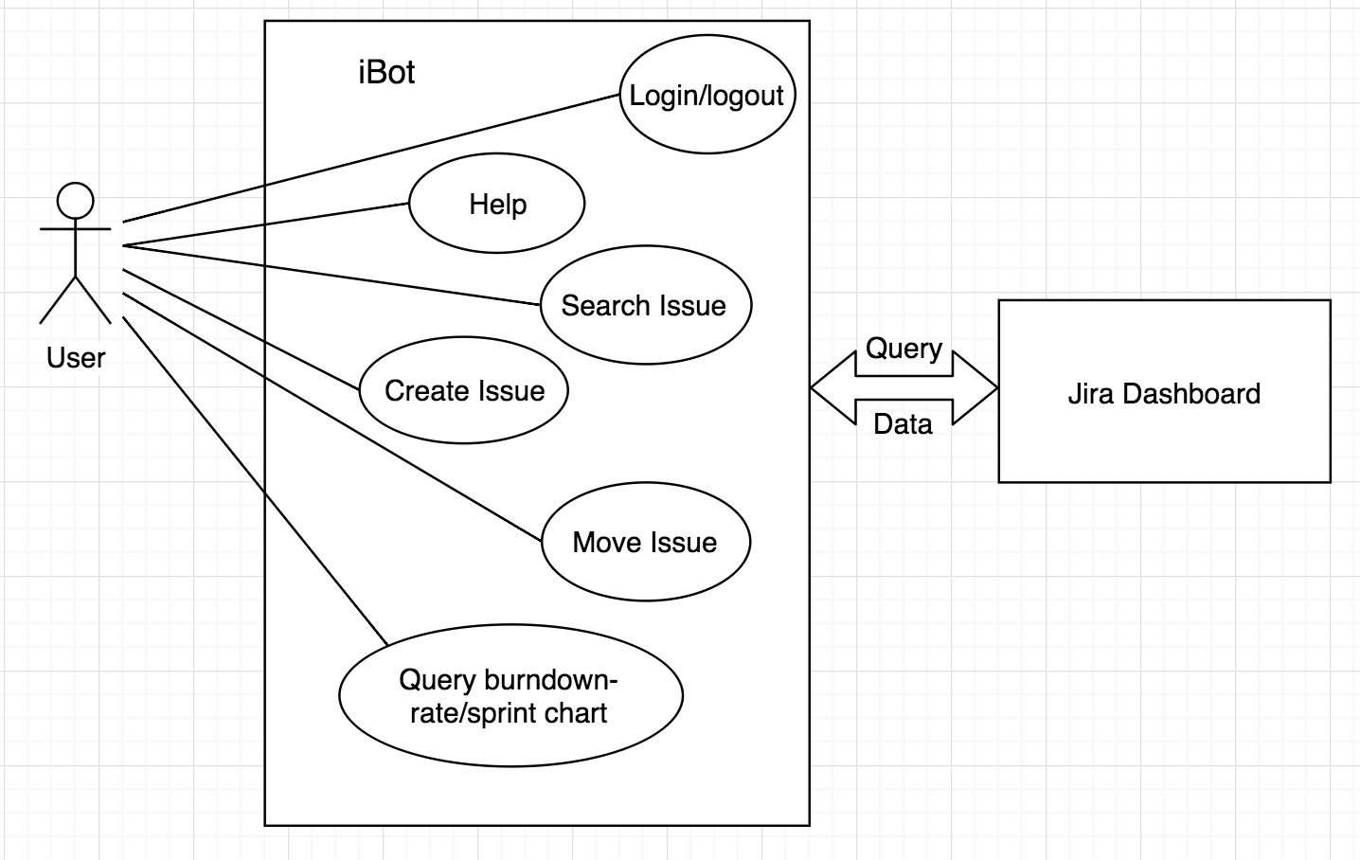
Use Case Diagram
Notes:
yun

Slide 13
Project Overview
Project Introduction
Testing
Requirements / User cases
Acceptance Criteria
In scope / Out of Scope / Deliverables
Project Schedule
Risks
Lesson learned
Notes:
xiao

Slide 14
Acceptance Criteria
ID | Acceptance Criteria | Conditions | Estimate | Business Value
1 | Short descriptions can be added to Jira issues | Yes | 1 | 3
2 | Comments can be added to Jira issues | Yes | 1 | 3
3 | Priority can be set to Jira issues | Yes | 2 | 2
4 | Status of an issue can be changed | Yes | 2 | 3
5 | Issues can be searched using keyword | Yes | 2 | 2
6 | User can get a list of available command from the robot | Yes | 2 | 3
7 | User can get the latest build information from Jenkins/Travis CI | No | 3 | 3
Notes:
young

Slide 15
Project Overview
Project Introduction
Testing
Requirements / User cases
Acceptance Criteria
In scope / Out of Scope / Deliverables
Project Schedule
Risks
Lesson learned
Notes:
xiao

Slide 16
In Scope
Interact with Jira:
Create issues
Search issues
Modify issues
Add comment
Set priority
Change issue status
etc.
Use LUIS to interpret natural language.
Set up rules to parse users’ intent.
Authentication
Cookie based authentication
Interact with other frequently used systems like Jenkins or Salesforce
Notes:
young

Slide 17
Out of Scope
Integrate voice recognition to enable more intuitive interation.
Requires extra libraries, accuracies are low.
Some applications does not provide direct voice input method.
Define domain specific language (DSL) to eliminate the ambiguity in natural language.
Requires too much time to develop/test.
Increases the cost of learning.
Interact with more DevOps tools
Notes:
young

Slide 18
Deliverables
A well functioning bot
Meet the requirements of Acceptance Criteria
Thoroughly tested, functional & unit test
Final Proposal
Requirements
User story
Acceptance Criteria
Project Schedule
Architecture Diagrams
Risks
Presentation to the class
Achievement we reached
Working Demo
Final presentation to sponsors at NetJets
Poster for visitors in Ohio Union
Introduction
Features
Products
Private GitHub repository
Notes:
young

Slide 19
Project Overview
Project Introduction
Testing
Requirements / User cases
Acceptance Criteria
In scope / Out of Scope / Deliverables
Project Schedule
Risks
Lesson learned
Notes:
xiao

Slide 20
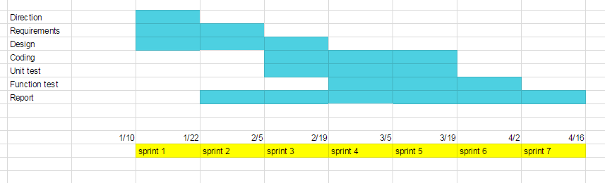
Project Schedule
Notes:
xuzhou

Slide 21
Project Overview
Project Introduction
Testing
Requirements / User cases
Acceptance Criteria
In scope / Out of Scope / Deliverables
Project Schedule
Risks
Lesson learned
Notes:
xiao

Slide 22
Risks
Need to be more familair with Authentication API (Coockie-Based Authentication)
Unable to locate the task under which iBot should add sub-tasks
Fuzzy search is a pretty new concept for us on which we may need to do more research
Notes:
xuzhou

Slide 23
Project Overview
Project Introduction
Testing
Requirements / User cases
Acceptance Criteria
In scope / Out of Scope / Deliverables
Project Schedule
Risks
Lesson learned
Notes:
xiao

Slide 24
Lesson Learned
Don’t be afraid to learn a new technology/tool
Most open source tools have user guide and API in order for us to use
Process of software development may take longer than we think
A project is not just the product. It requires more (eg. Documentation, Test cases)
Agile Methodology increases the efficiency of the project
It keeps track the progress of the project, and makes the whole process methodic
Do not start writing code before clearly userstand the need of customer
Write related documentation and come up with an acceptable plan first in order to get rid of unnecessary waste of time
Notes:
xuzhou

Slide 25
DEMO
Notes:
xiao

Slide 26
Thanks!

